Slide 1
CS 0007: Introduction to Java
Lecture 1
Nathan Ong
University of Pittsburgh
September 1, 2016

Slide 2
And Java is not just an Indonesian Island or a Type of Coffee
Not Your Usual Best Buy Pitch for a Computer

Slide 3
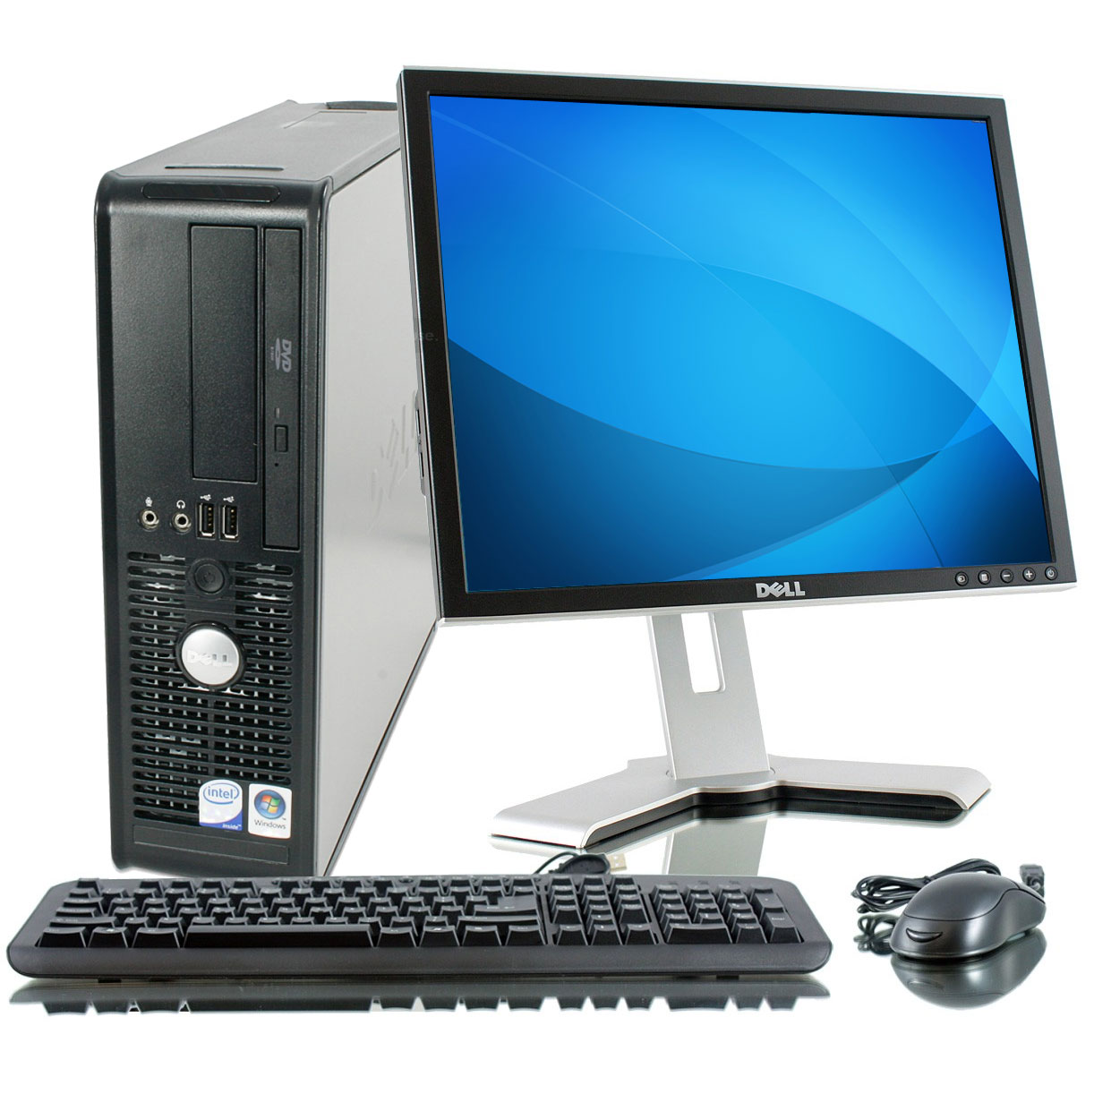
What Happens in that Magical Box?
Source: http://ak1.ostkcdn.com/images/products/77/822/L13881092.jpg

Slide 4
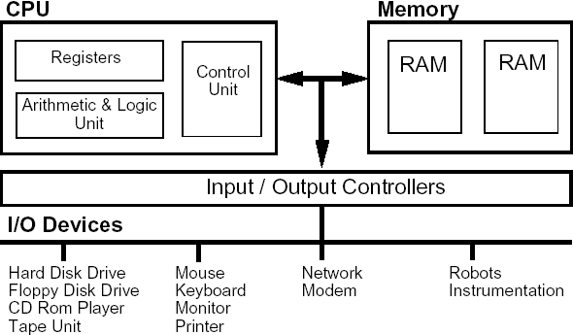
How a Computer is Organized
Source: https://www.doc.ic.ac.uk/~eedwards/compsys/overall.gif

Slide 5
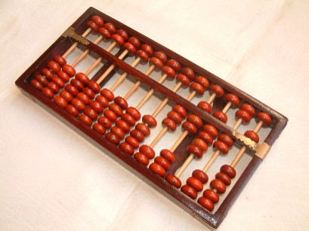
History of Computing
Source: https://upload.wikimedia.org/wikipedia/commons/e/ea/Boulier1.JPG

Slide 6
History of Computing
??? – Math invented
~2400 BC – Abacus probably invented in Babylon
??? – More math invented
1600s – John Napier discovers logarithms and fast log computation
1786 – Johann Müller theorizes a "Difference Engine"
1822 – Charles Babbage ("father of the computer") secures funding to build a Difference Engine (never built)
Notes:
"difference machine" – essentially a mechanical calculator of logarithms and trigonometric functions to approximate polynomials

Slide 7
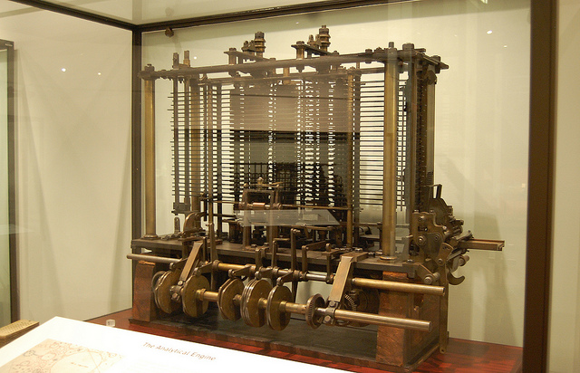
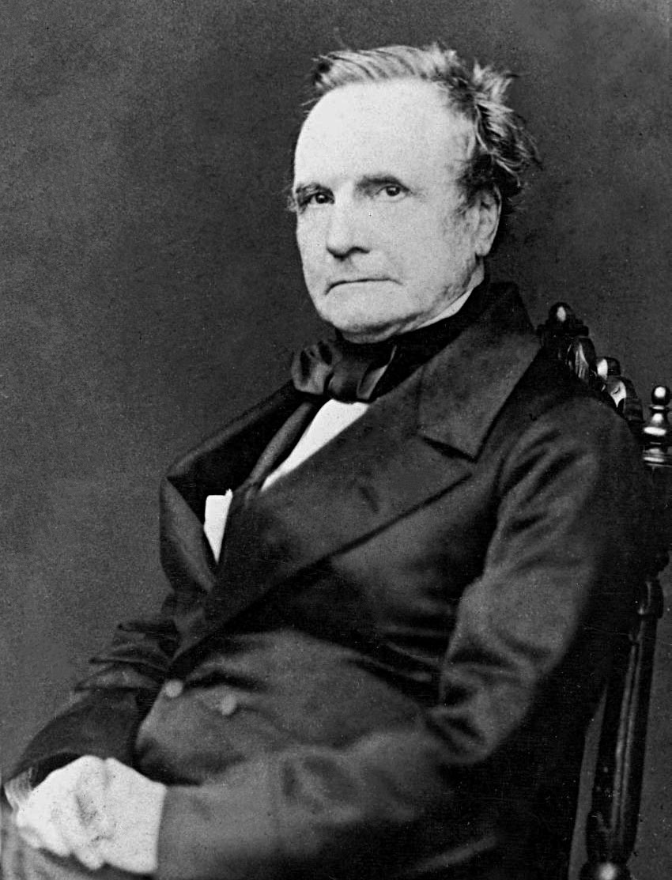
History of Computing
1837 – Charles Babbage designs "Analytical Engine"
1841 Prototype on display at The Science Museum in London
(Source: https://s3.yimg.com/te/8543/8649286817_a3042f2c29_z.jpg)
Notes:
Started 1834
Babbage source: https://upload.wikimedia.org/wikipedia/commons/6/6b/Charles_Babbage_-_1860.jpg

Slide 8
Analytical Engine
Babbage's Engine is considered the first general-purpose computer
Could handle basic math operations, logic, loops, conditional branching, and had some primitive memory
Powered by a hand-crank
The full-scale version was never built, due to inadequate funding
Notes:
"difference machine" – essentially a mechanical calculator for polynomials, logarithms, and trigonometric functions

Slide 9
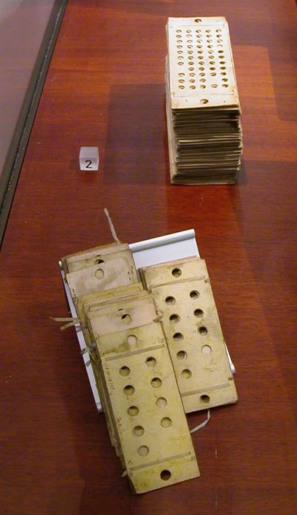
Analytical Engine
Accepted two kinds of punch cards:
  Top: "Variable Cards" (Data)
  Bottom: "Operational Cards" (Instructions)
Punch cards were not new (used to direct mechanical looms at the time)
Source: https://upload.wikimedia.org/wikipedia/commons/0/0d/PunchedCardsAnalyticalEngine.jpg

Slide 10
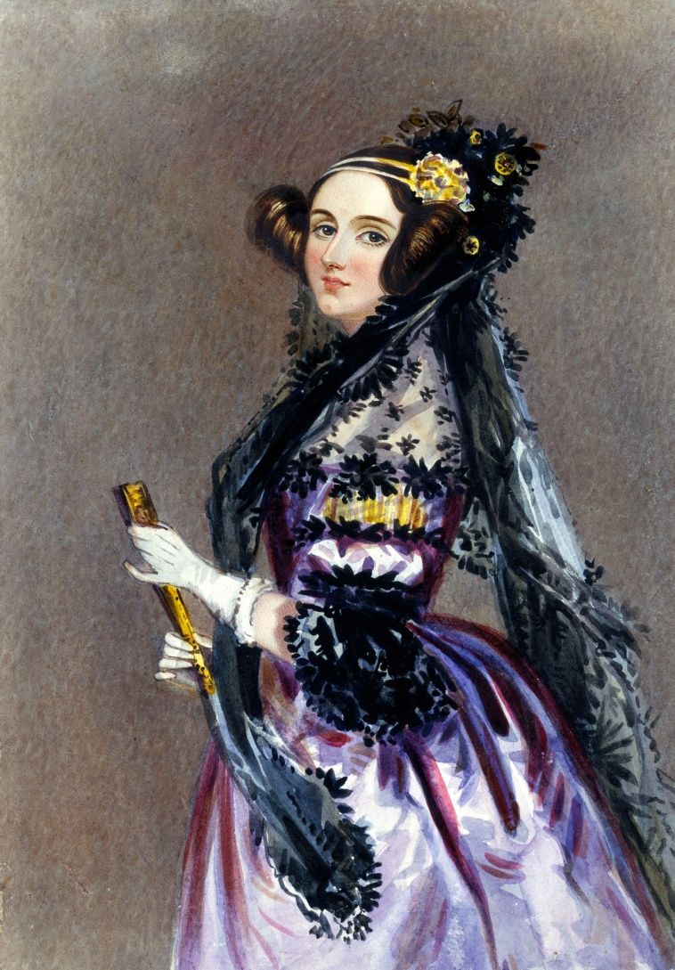
Ada Lovelace
In 1842, she recognized the usage of multiple, non-direct, complex operations and memory could generate Bernoulli numbers using Babbage's Analytical Engine.
This is the first computer program.
Source: https://upload.wikimedia.org/wikipedia/commons/a/a4/Ada_Lovelace_portrait.jpg

Slide 11
Side note: Yes there is a fan-fiction ship musical for Babbage and Lovelace.

Slide 12
History of Computing
1885 – AT&T (the company behind the operating system Unix and the programming language C) founded
1906 – Xerox (the company behind desktops and the computer mouse) founded
1907 – Vacuum tube invented
1911 – IBM (the company behind hard disks and floppy disks) founded
1931 – Charles Wynn-Williams published first usage of electronics in computation
Notes:
"difference machine" – essentially a mechanical calculator of logarithms and trigonometric functions to approximate polynomials

Slide 13
History of Computing
1938 – Claude Shannon published first usage of electronics in Boolean algebra computation
1946 – Alan Turing publishes a paper on programs stored and read from tape
– The ENIAC, the first electronic general- purpose computer, was developed
1947 – Transistor invented
– Cathode Ray Tube (CRT) Random Access Memory (RAM) invented

Slide 14
History of Computing
1952 – Grace Hopper invents first compiler
1956 – Hard disk invented
1957 – FORTRAN invented
1958 – Integrated circuit (chip) invented
– LISP invented
1960 – COBOL invented
1962 – First computer game created
1963 – Computer mouse invented

Slide 15
History of Computing
1964 – BASIC invented
1965 – First supercomputer developed
– Gordon Moore publishes his famous "Moore's Law"
1968 – Moore founds Intel (the company behind CPUs and other chips)
1969 – ARPANET (predecessor to the Internet) developed
– UNIX developed
1970 – Integrated Circuit Dynamic-RAM developed
– Pascal invented

Slide 16
History of Computing
1971 – Intel develops first commercially available microprocessor (4004)
– Famous "P vs. NP" problem stated by Kurt Gödel
– Floppy disks invented
1972 – C invented
1975 – First personal computer sold (Altair 8800)
– Microsoft founded
1976 – Apple founded
– LISP invented

Slide 17
History of Computing
1978 – SQL invented
1982 – Sun Microsystems (company behind Java) founded
1984 – C++ invented
1985 – CD-ROM developed
1989 – World Wide Web invented
1991 – Linux invented
1993 – Concept of an Internet search engine developed

Slide 18
History of Computing
1994 – First smartphone developed
1995 – USB invented
– DVD-ROM invented
– Java invented

Slide 19
Java Today
Oracle acquired Sun Microsystems in 2010.
One of the most widely used languages, primarily found in business enterprises, web applications, or mobile phones (i.e. Android).
Current version: Java SE 8u102

Slide 20
Why Learn Java?
Widely used
Constantly updating and receiving support
Easily understood due to standardized and consistent syntax
Forces code readability
Virtual Machine isolates running code

Slide 21
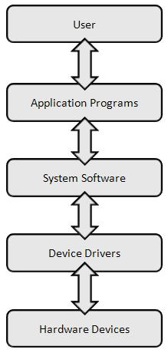
Software Layers
Applications: Software that interfaces with the user
System Software: Operating System (e.g. Windows, Mac OSX, Linux)
Device Drivers: Software to talk to non-computer devices (e.g. printers, webcams, etc.)
Source: http://cs.sru.edu/~mullins/cpsc100book/images/softwareLayers.jpg

